Slide 1
Facial Reconstruction using Speech

Slide 2
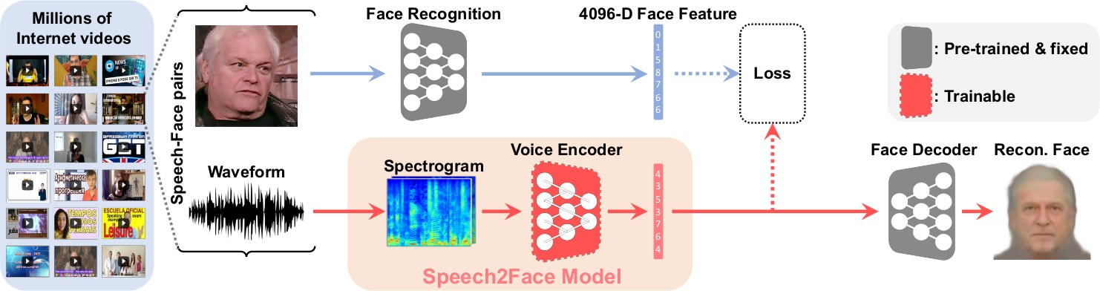
Abstract
In this project, we perform the task of reconstructing a facial image of a person from a short audio recording of that person speaking.

Slide 3
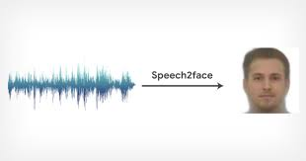
Introduction
There is a strong correlation between speech of a person and his/her appearance, part of which is a direct result of the mechanics of speech production: age, gender (which affects the pitch of our voice), the shape of the mouth, facial bone structure, thin or full lips — all can affect the sound we generate. In addition, other voice-appearance correlations stem from the way in which we talk: language, accent, speed, pronunciations. In this project, our goal is to predict a recognizable image of the speaker’s face and to capture dominant facial traits of the person that are correlated with the input speech.

Slide 4
So,How will we do it?
We will design a neural network model that takes the complex spectrogram of a short speech segment as input and predicts a feature vector representing the face. More specifically, face information is represented by a 4096-D feature that is extracted from the penultimate layer (i.e., one layer prior to the classification layer) of a pre-trained face recognition network. To train our model, we use the AVSpeech dataset .We decode the predicted face feature into an image of the person’s face using a separately trained reconstruction neural network model.

Slide 5
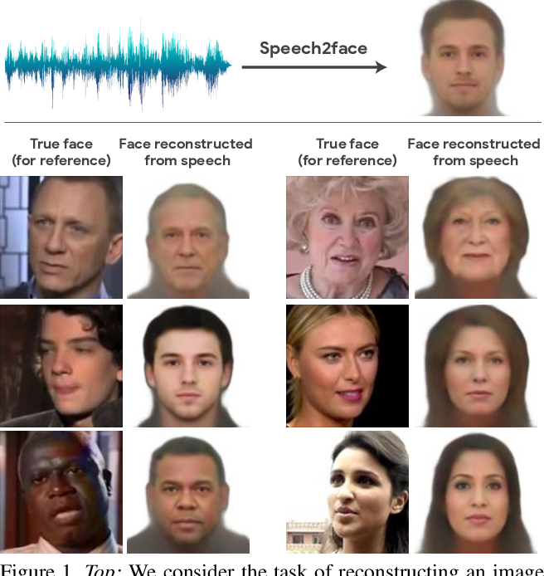
The Model
The large variability in facial expressions, head poses, occlusions, and lighting conditions in natural face images makes the design and training of a SpeechToFace model non-trivial. A very straightforward approach of regressing from input speech to image pixels does not work because such a model has to learn to factor out many irrelevant variations in the data and implicitly extract a meaningful internal representation of faces — a challenging task by itself. We will use the same pipeline as the Speech2Face

Slide 6
More on Model
As shown in Figure The Model comprising of two main components:
1) a voice encoder, which takes a complex spectrogram of speech as input, and predicts a low-dimensional face feature that would correspond to the associated face; and
2) a face decoder, which takes as input the face feature and produces an image of the face.
We will train the voice encoder module that predicts the face feature in a supervised manner where the ground truth features are generated from corresponding face image of the person using a pre-trained VGG-Face model and the face decoder model proposed was not available open source, so we will implemented our own decoder.
During training of encoder, the face decoder is fixed, and the voice encoder that predicts the face feature is only trained. Moreover the complex spectrogram input and the 4096-D VGG face features (used to compute loss function) are precomputed to speed up the training process.

Slide 7
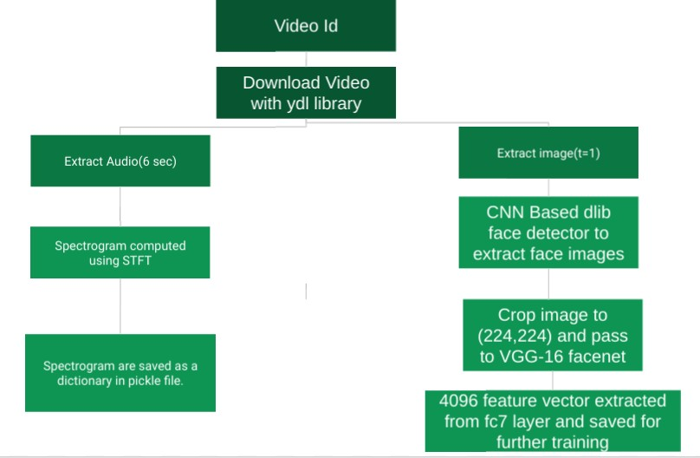
Preprocessing
We will be using the AVSpeech dataset , 2018 comprising of thousands of video segments from YouTube. Other libraries and tools that we used for pre-processing are described below
youtube-dl download the videos from the csv files corresponding to start and end times.
moviepy - extract audio and frames separately from the video.
librosa and tensorflow -compute stft and power law compression
dlib and face recognition - find faces from a particular video frame
vgg16-facenet - extract vgg features i.e. 4096 vector form faces.
Preprocessing Pipeline

Slide 8
Dataset
We have used AVSpeech Dataset for Voice Encoder training, details are as follows :
Training Data : 8400 videos
Validation Data : 395 videos
Test Data : 402 videos
We have used UTKFace Dataset for Face Decoder training, details are as follows :
Training Data : 5900 images
Validation Data : 300 images
Test Data : 280 images

Slide 9
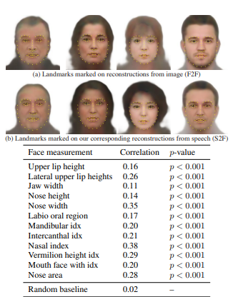
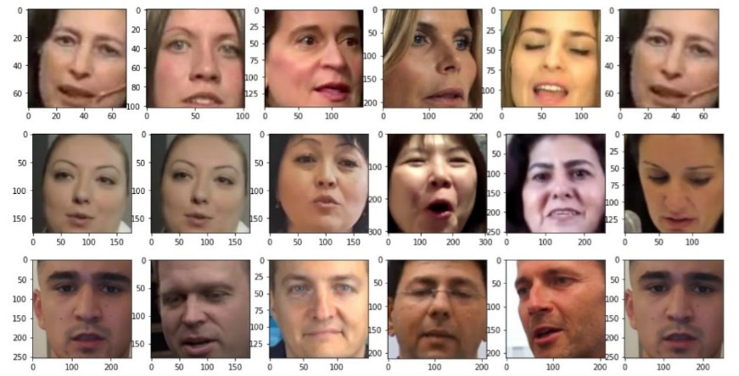
Result
We test our model both qualitatively and quantitatively on the AVSpeech dataset dataset.
Our goal is to gain insights and to quantify how—and in which manner—our Speech2Face reconstructions resemble the true face images.
Face Retrival Examples
Person correlation coefficient

Slide 10
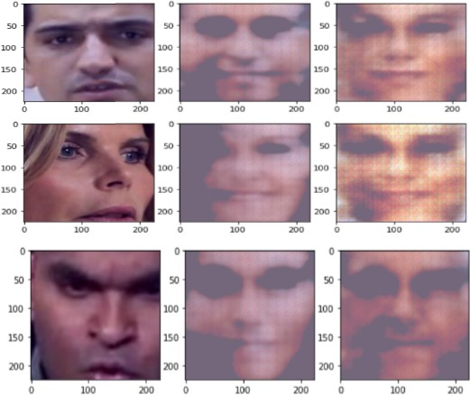
Analysis
Face Retrival Performance We query a database of 400 face images by comparing our Voice Encoder prediction of input audio to all VGG-16 face features in the database. For each query, we show the top-5 retrieved samples. It can be seen from the retrieved images in Figure that model has learned various physical attributes such as age and gender since in all the rows, the retrieved images have same gender and similar age as the query image. In row 2: the first 3 matching images have same expression as the query image.
S2F Output From figure,the first column shows original image of speaker, second column image is generated by actual VGG16 face features fed to decoder and third column image is output of our Speech2Face model on input audio waveform. It can be observed that images generated by decoder on audio features are quite similar to that generated using VGG features except the landmarks, but very significant difference can be seen between images generated using VGG features and original image of speaker.

Slide 11
Limitations
The data preprocessing step for the task is very time consuming for the AVSpeech Dataset 2018 because of the downloading and computing audio spectrograms and the face features.
We will preprocessed around 9000 videos (compared to 1.7 million by original paper) and it took around 3-4 hrs per 1K videos. Also the original Voice Encoder proposed contains around 760 million parameters, with which it was not possible to train it on google colab so we will decreased the voice encoder complexity.

Slide 12
Conclusion
We have presented a novel study of face reconstruction directly from the audio recording of a person speaking. We
address this problem by learning to align the feature space of
speech with that of a pre-trained face decoder using thousands
of natural videos of people speaking. We have demonstrated
that our method can predict plausible faces with the facial
attributes consistent with those of real images

